Slide 1
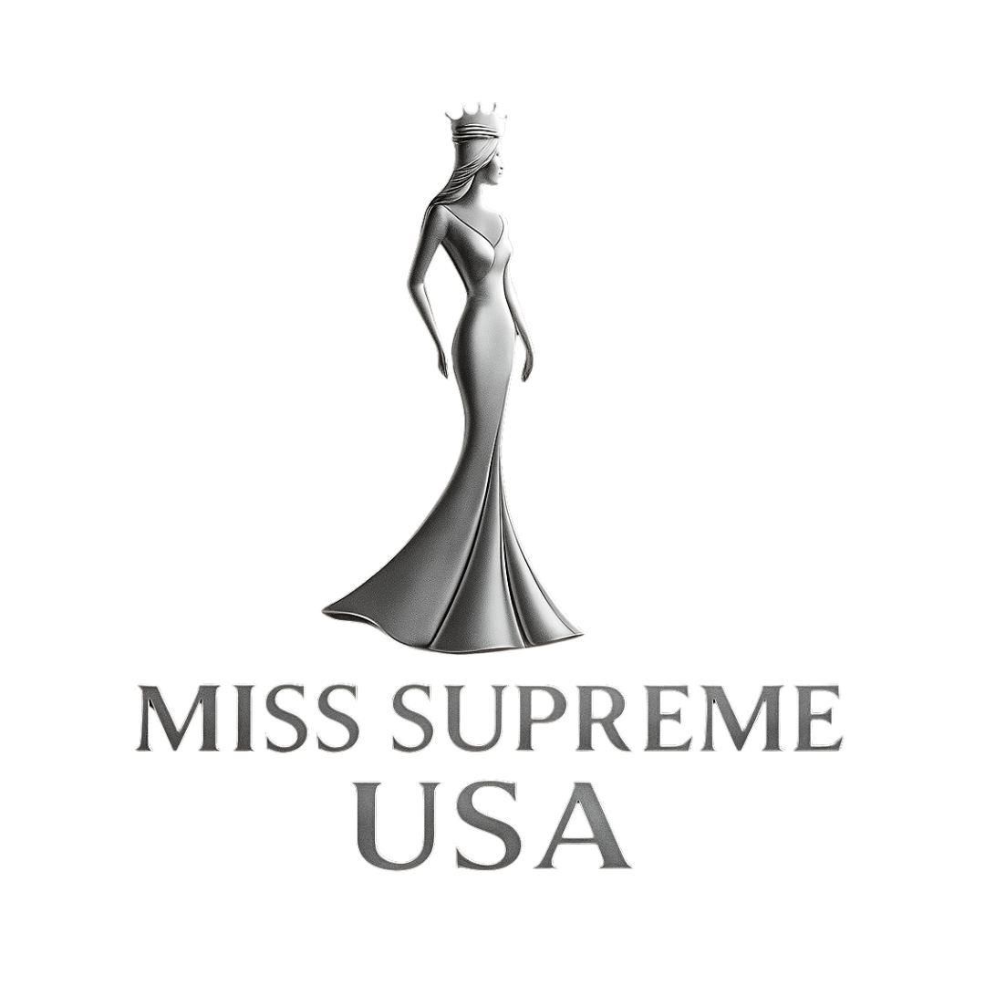
Contestant Handbook 2026

Slide 2

Miss Supreme USA 2026
Welcome Letter
Payments
Arrival Information
Headshots Requirements
Areas of Competition
Wardrobe Requirements
Code of Conduct

Slide 3
Why Join Supreme
Miss Supreme Pageant is more than just a competition—it's a powerful platform designed to uplift, empower, and celebrate every contestant who walks across the stage. While there will be a crowned winner, every girl leaves feeling like a queen.
This pageant isn’t just about beauty. It’s about confidence, personal growth, community, and using your voice to make a difference. Whether you're stepping on stage for the first time or returning to chase a dream, Miss Supreme provides a supportive environment where your individuality shines and your story matters.
At Miss Supreme, every contestant is given the tools, stage, and spotlight to build self-esteem, make lasting friendships, and gain life-changing experiences. The journey doesn't end with a crown—it starts with discovering your own power.
You don’t need a crown to be Supreme. Just the courage to show up as you.
Join us and be part of something greater. A sisterhood. A movement. A platform where you are seen, heard, and celebrated.
“Miss Supreme - Where Every Girl Reigns Supreme”

Slide 4
Welcome Letter 2025
This rare chance allows a select few to represent their state or region and grow personally in the spotlight. Remember, success isn't just about winning—it's about preparation, competition, and your response to the results. We can't wait to see you shine on our stage!
OUR TEAM IS AVAILABLE TO
ANSWER ANY QUESTIONS. ALWAYS FEEL FREE TO REACH OUT TO US IF YOU NEED ANY ASSISTANCE.
INFO@MISSSUPREME.COM
713-775-6232

Slide 5
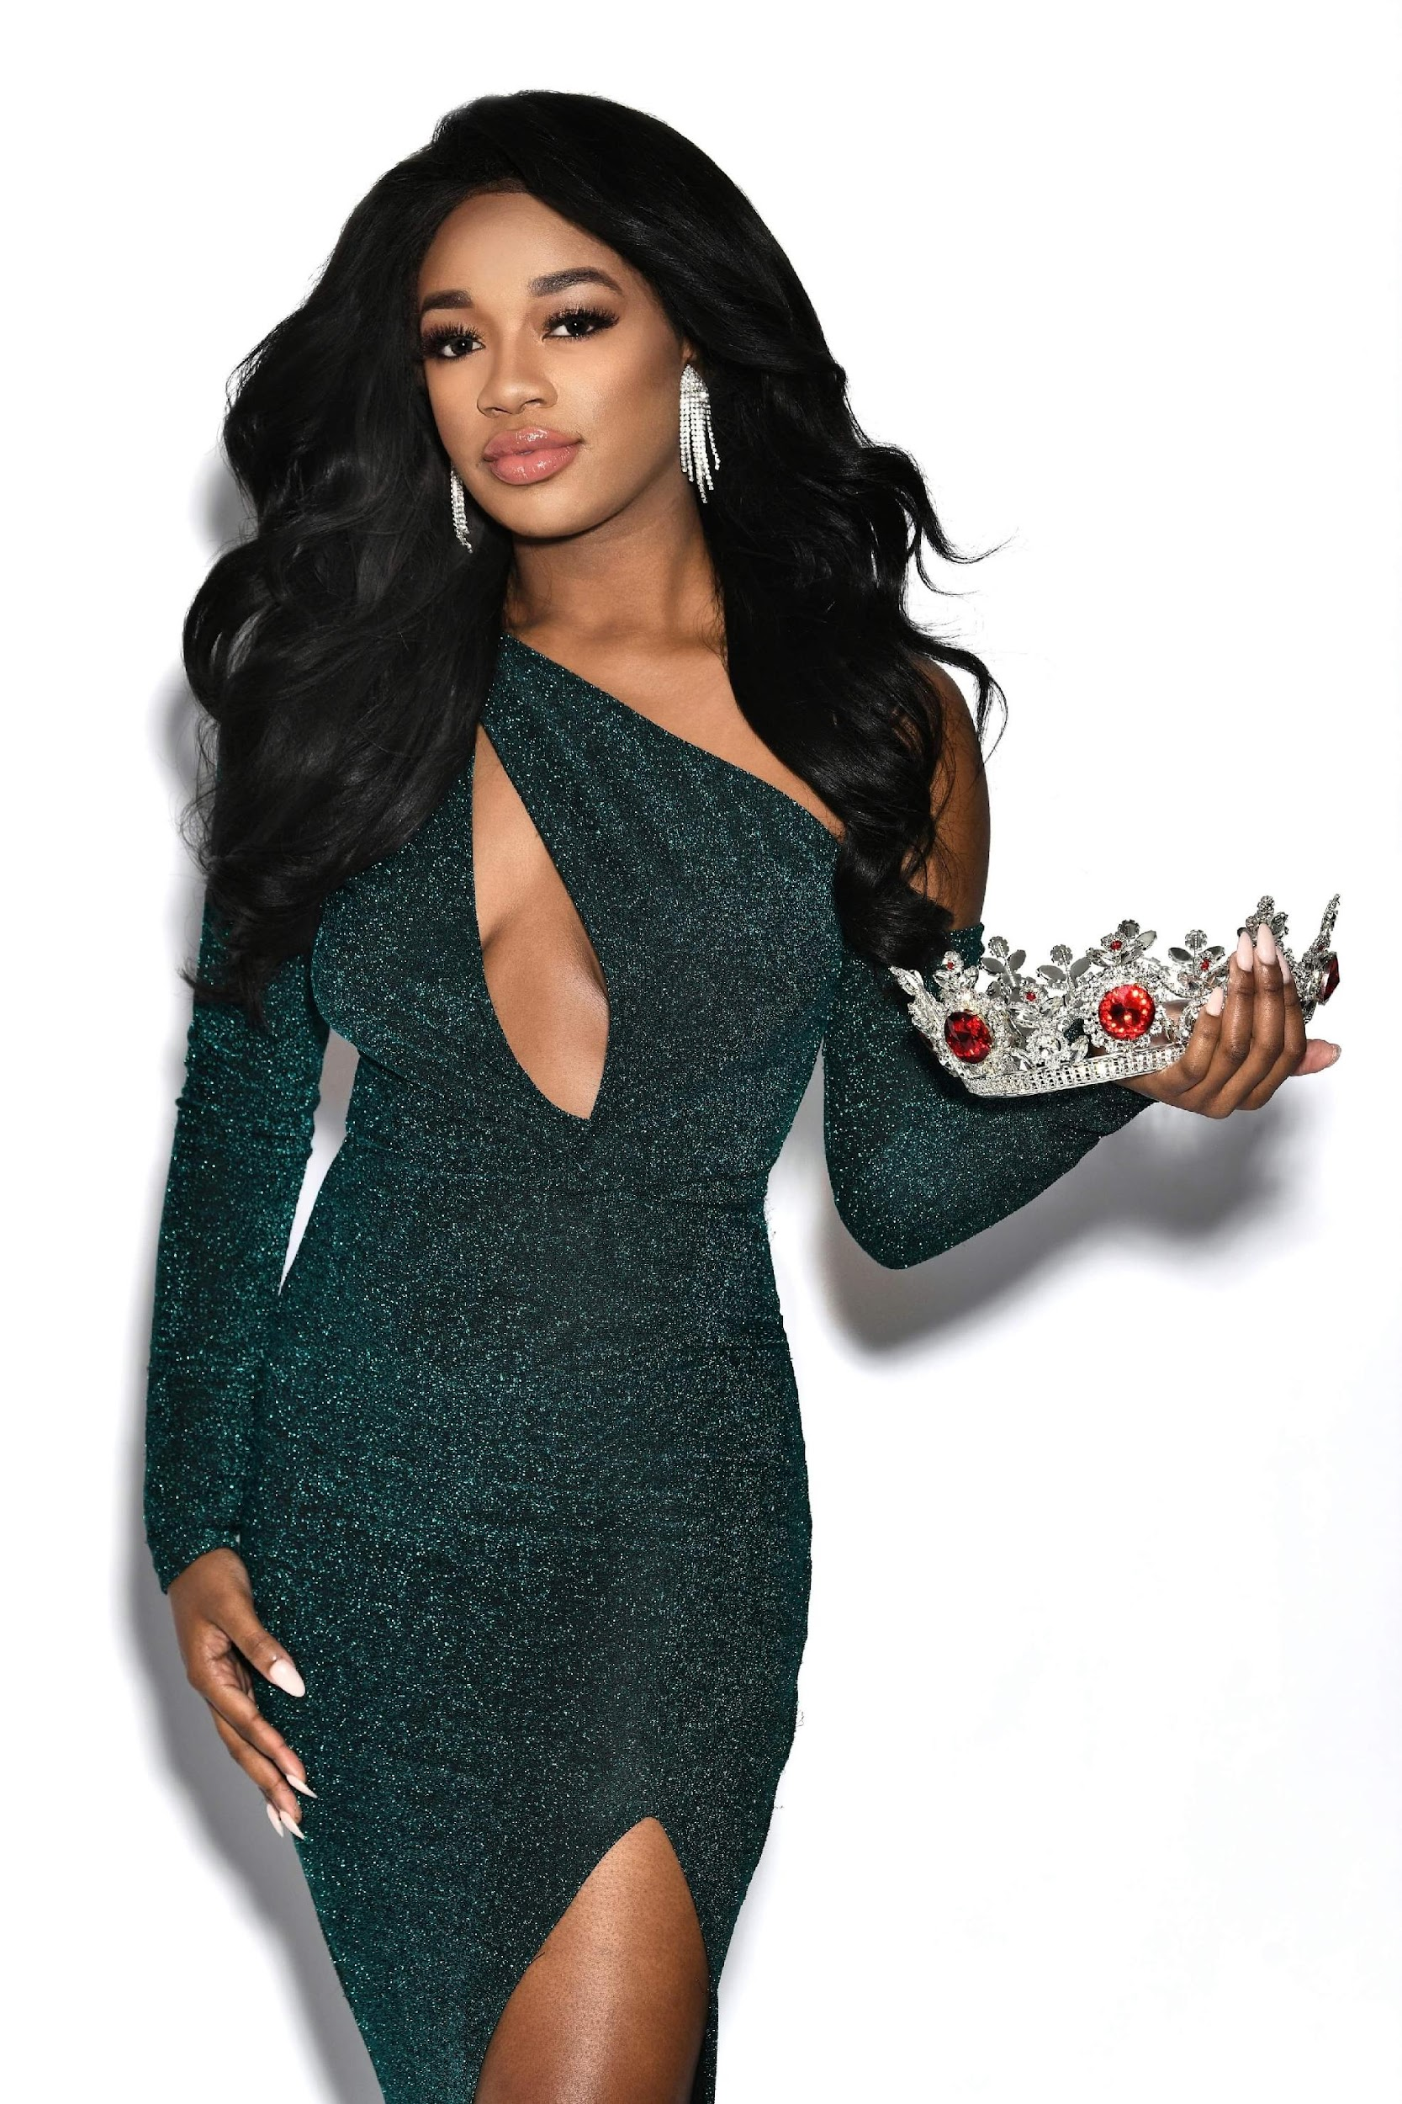
Payment Information
The fee is $890
$595.00 due at the time of registration
$295.00 due no later than March 31st
The fee includes the hotel accommodations, meals, official crown, official sash
If making payments plans, last payment should be made by March 31st 2026th.

Slide 6

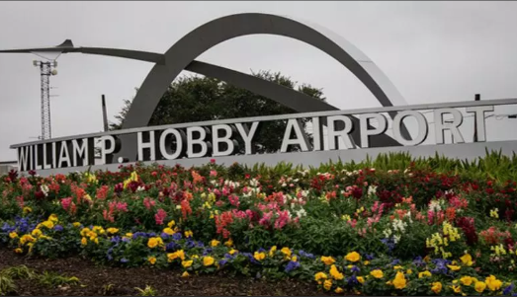
Airport Information
George Bush Intercontinental Airport
William Hobby Airport

Slide 7
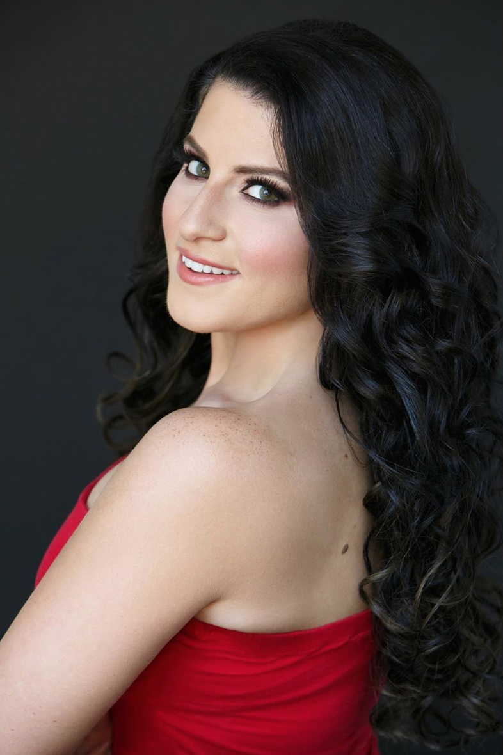
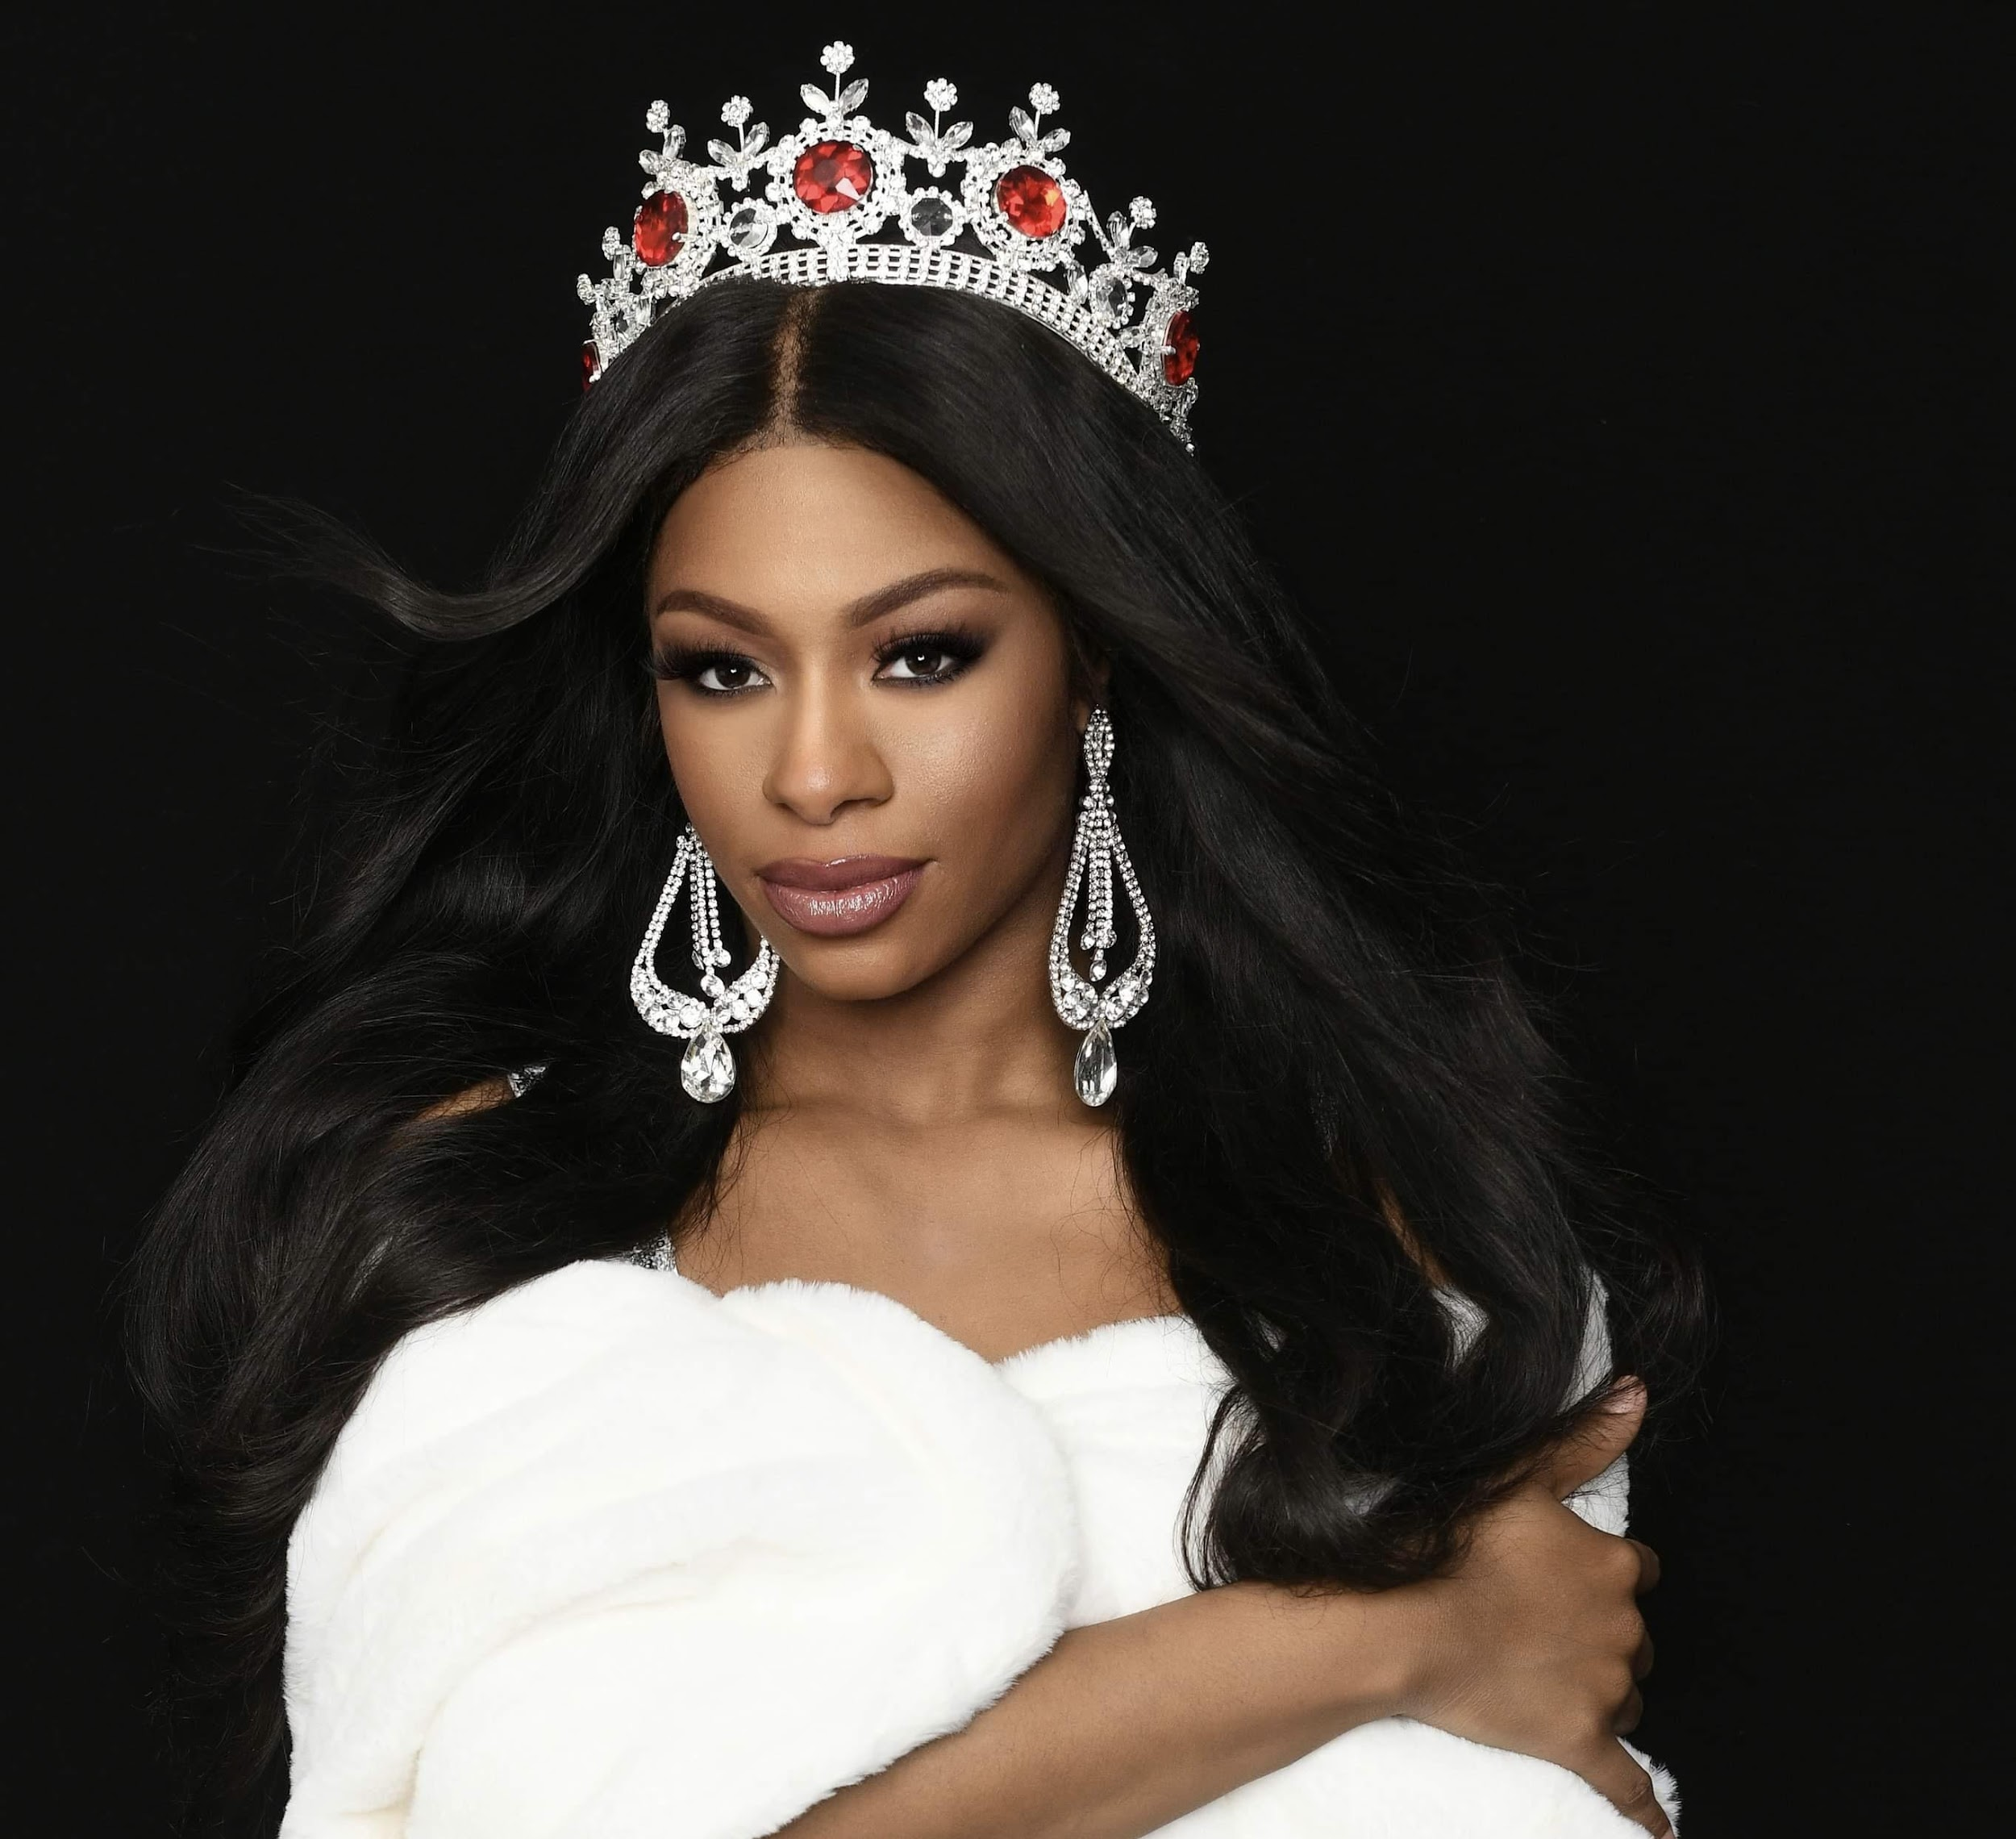
Headshots Requirements
White, gray or black background PREFERRED.
No oversized accessories that will cover the face.
No headpieces allowed on headshots except for the crown.
2 headshots required - 1 with the Supreme crown and 1 without it.
  Optional - Any additional professional photos
One of the headshots is for contestant announcements due 2 weeks after deposit (Can be sent with deposit as well)
Deadline for submission of second photo: March 31st

Slide 8
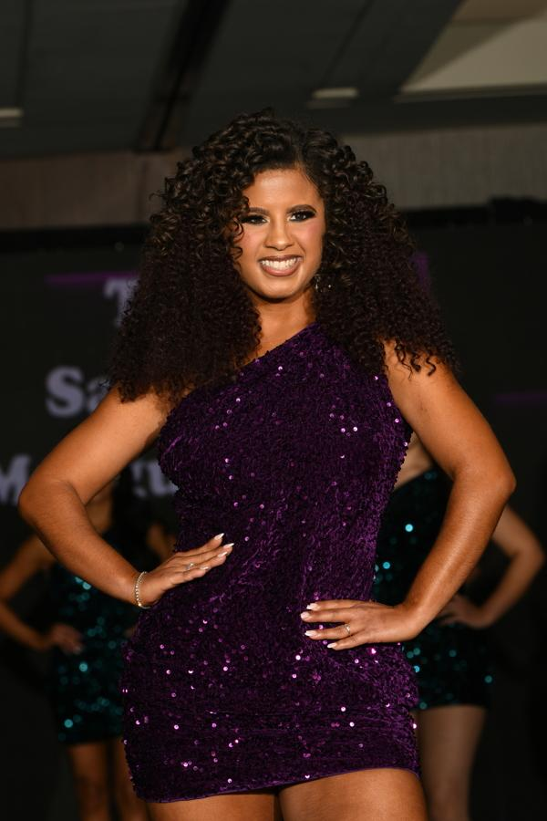
Areas of Competition
Miss Supreme USA:
Preliminary Interview
Swimsuit Preview
Swimsuit (Finals)
Evening gown (Finals)
Final Question (Finals)
Total combined score from these areas of competition determines the winner

Slide 9
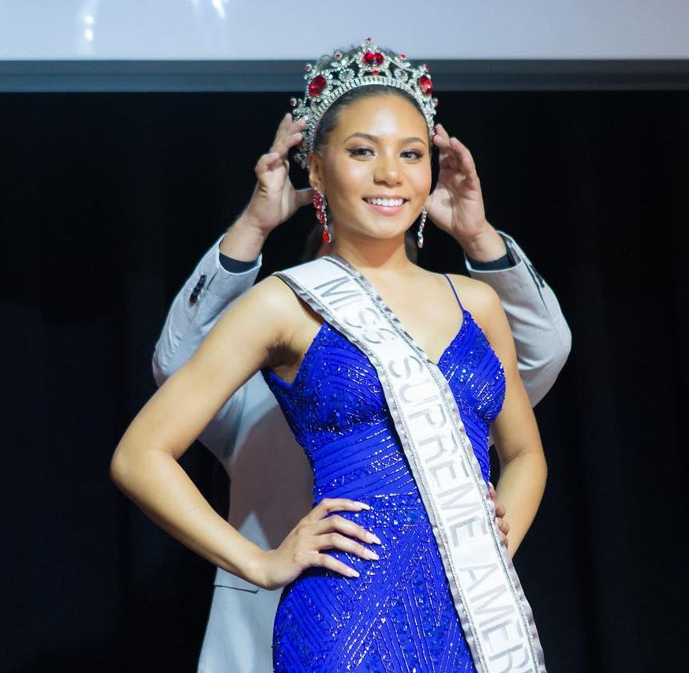
Wardrobe Requirements
One evening gown of your choice
One silver or gold swimsuit of your choice (one piece or two-piece), no metal or rhinestones
One interview outfit
2 Comfortable but cute outfits for rehearsals
Nude Heels
1 Red outfit (Jumpsuit, cocktail dress or full-length dress)
Accessories of your choosing

Slide 10
Code of Conduct
Delegates must attend and be punctual for all events, as tardiness will affect judging.
Sashes should be worn at all times.
Respect your chaperone; they are not personal attendants or cleaners.
As a responsible titleholder, adhere to your contract and obligations, including participation in the live-streamed gala; if you choose to withdraw, notify the organizers immediately.
Secure your belongings—our organization is not liable for loss.
Maintain respect and kindness towards all; our NO DRAMA POLICY will enforce disqualification for severe behavior breaches.
The agenda may change as needed; any changes will be communicated promptly.

